Slide 1
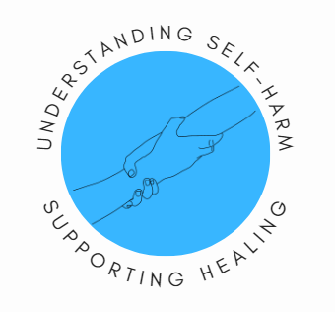

“I think that’s just confirmation bias”: A worked case example of reflexive thematic analysis from a survivor standpoint
Caroline da Cunha Lewin
Caroline.dc.Lewin@kcl.ac.uk
Nurse and Lived Experience PhD Researcher Service User Research Enterprise (SURE), IoPPN

Slide 2
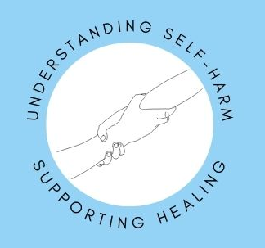
Objectives
To examine my approach, as a ‘Big Q’ LE researcher, of intertwining my lived (and professional) experiences and understanding of self-harm in data analysis
To explore a survivor approach, including its epistemology and applied methodology
To discuss reflexive thematic analysis, with worked case example
To broaden methodological understanding of LE research and the subjectivist position
Notes:
*PPI group attached to this work ** within a Big Q approach
*** but also, better understand the Big Q process, so this has relevance not just for people wishing to centralise their LE, and refer to resource that strengthens that but also for researchers wishing to improve their understanding of a subjectivist position where the researcher’s subjectivity is not a hindrance to ‘truth’ but a resource for unique knowledge production

Slide 3
Structure of today’s session
Background: survivor paradigm, including its epistemology and central tenets
Methodology: trustworthiness and rigour, positionality and RTA method
Discussion: worked case example
Notes:
*”lack of generalisability”, “bias”, “Cherry-picking”

Slide 4

Quick query
What do you expect to learn during this training?
Is there anything you hoped would be discussed?
Notes:
https://www.menti.com/alztg6q5enzy

Slide 5
Survivor paradigm
The “I”
The “We”
Epistemic justice
Notes:
Central tenets of survivor approach: “I”, “We”, political positioning. Social justice movement – emancipation of people’s voices.
Subjectivist position: first-person perspective typically centralises social- and trauma-based understandings, constructing experiences not as psychopathological ‘symptoms’, but as survival mechanisms, strengths-based approach
Moving to the ‘We’: whilst there may be resonance between my experience and yours, this does not mean there is a sense of “knowing” someone else, rather the hope is moving together, meeting each other, being with. Herman?
Epistemic justice
Psychiatrisation inherently involves epistemic injustice
One’s position as a ‘knower’ is delegitimised (LeFrancois et al., 2013)
Labelled with a mental ‘illness’ undermines one’s credibility and rationality
Power inequity, where clinician = expert, risks replicating abusive dynamics
Work towards “undertak[ing] research not with the certainty that it could lead to the kind of change that survivors might want, but with that in mind” (Faulkner, 2004: 5),
Development of LE-centric knowledges and;
Alternative approaches to healing grounded in community priorities, not clinical ones
Adoption of the ‘survivor’ identity is a political statement (Sweeney et al., 2009)

Slide 6

Survivor paradigm
Anorexia nervosa
Individuals commonly have a BMI is a lower than 18.5. Patients typically resist attempts to help restore nutrition and weight. A notable feature of AN is that the individual does not experience herself or himself ‘sick’.
Eating distress
‘AN’ makes visible how ‘bodies are both acted upon and have agency’ (Schott & Langan, 2021).
“One day, I will be thin enough. Just the bones, no disfiguring flesh, just the pure clear shape of me...” (Fuchs, 2022: 113).
Notes:
Anorexia nervosa’ (AN) is a mental ‘illness’ characterised by abnormal eating behaviours and excessive preoccupation with food, body weight and shape. Individuals commonly have a BMI is a lower than 18.5. Patients typically resist attempts to help restore nutrition and weight. A notable feature of AN is that the individual does not experience herself or himself ‘sick’. AN carries biological consequences but there are also underlying genetic findings and neuropsychological endophenotypes to explain causation (Treasure et al., 2015).
“Through constructions of anorexia that were detailed to me in treatment, I learned new ways of doing anorexia” (O’Connell, 2023: 275)
“One day, I will be thin enough. Just the bones, no disfiguring flesh, just the pure clear shape of me...” (Fuchs, 2022: 113).
‘AN’ speaks of a complex, entanglement of embodiment, gender, self-identity and social inequity (Malson, 2023)
‘AN’ mirrors the experience of what most, if not all, women and people gendered as women face: “My female body carries with it its own strong and clear signals to others about who I am and how I am to be treated” (Lester, 1997: 485).
‘AN’ makes visible how ‘bodies are both acted upon and have agency’ (Schott & Langan, 2021).

Slide 7
Overall…
Survivor approach capitalises on the subjectivity of the LE researcher and peers with LE
Being close to the topic produces novel understanding closer to community reality (Beresford, 2003)
Survivor approach aligns with the ‘Big Q’ qualitative paradigm
“What we see within the data inevitably reflects who we are” (Terry et al., 2017: 37)
Notes:
Because of the valorisation of the subjectivist position, survivor approaches …

Slide 8
Methods
PPI
Reflexivity
Reflexive thematic analysis
Notes:
Central tenets of survivor approach: “I”, “We”, political positioning.

Slide 9
Methods
Positivistic paradigms are often incorrectly applied:
Braun & Clarke (2025) note qual researchers having to justify how they ‘avoided’ bias
Survivor approaches
As above
A lack of generalisability and objectivity, ‘agenda’, cherry-picking, overt accusations of omitting evidence
The researcher is a central instrument in knowledge production
Methodological integrity and reflexive openness (Braun & Clarke, 2025)
Notes:
Check this SLIDE Not removal of bias but methodological integrity and reflexive openness

Slide 10
Methods
Patient and Public Involvement
Participatory methodology is the inclusion and involvement of people with LE
Greater ownership over one’s voice and experiences
Influence over the research lifecycle as equitable partners
Serving an emancipatory function
Lived Experience Advisory Panel (LEAP):
Reflexive discussion within a reciprocal space
Explore my own limitations and the implications of this research lifecycle
Notes:
Capture the ‘We’, heterogeneity

Slide 11
Methods
Reflexivity, or ‘reflexive looping’ (Sweeney & Beresford, 2020)
All researchers should seek for critical self-awareness
Reflecting upon identities, ideological positioning and assumptions
Make visible what we have come to know, and how (Day, 2012)
Written reflections (and sometimes art-based) on developing understanding and research practice
Engaging with literature and attending training
Learning from and with colleagues with and without LE
Notes:
Capturing both central tenets. ‘Having’ LE does not ensure equity amongst peers, provide oneself with the ability to speak to all people or achieve a more ethical approach, rather it is how identity that is used which is critical.

Slide 12
Positionality statements
How do you approach positionality?
What questions do you ask yourself?
Notes:
Read out examples
https://www.menti.com/alztg6q5enzy

Slide 13
Positionality statements
Who am I?
What is my lived experience? Where do I think this comes from?
Why do I investigate this topic?
How do others see me?
How do I see myself?
How does who I am influence how I engage with others, in my research?
How have I changed because of my research?
What are my assumptions? Where do these come from?
(see da Cunha Lewin, 2025)
Notes:
Read out examples
https://www.menti.com/alztg6q5enzy

Slide 14
Positionality statements
Should be “uncomfortable and confronting” (see Gani & Khan, 2024)
Gani & Khan (2024) discuss the performativity of positionality statements as admissions/assuaging of one’s white guilt and privilege
Obstructive and inactive, re-centring oneself without thinking about how minoritised peoples are affected by oppression
Without authentic reflection on how we can work towards mitigating against harm, we risk continually replicating oppressive dynamics (Filson, 2023)

Slide 15
Reflexive thematic analysis
RTA Phases | Descriptions
Phase 1 – Familiarisation | Reading and re-reading data to understand the content, making notes of arising thoughts and interpretations, beginning to generate meaning and patterns
Phase 2 – Coding | Line-by-line review, attributing a code name to each datum
Phase 3 – Generating initial themes | Coding and theme development grounded in meaningful (not frequency), quotes exemplify themes
Phase 4 – Theme review | Themes reviewed to ensure they tell coherent story of the data
Phase 5 – Theme defining and naming | Naming and defining themes to capture main essence
Phase 6 – Report production | Revisiting all past stages to re-evaluate and reflect upon data (check myself)

Slide 16
Reflexive thematic analysis
RTA Phases | Guiding reflexive questions
Phase 1 | What do I feel as I read the data? Where do such feelings sit? What accounts for this? What is my immediate understanding of the text? How does it, or does not, resonate with my experience and myself? Can I relate to what is being said? What are my limitations in connecting with this? How can I account for my limitations? What do I see as meaningful, or not?
Phase 2
Phase 3 | Which codes and themes do I see as meaningful? Why? How do themes intertwine with research objectives? Which parts of myself and my experiences relate, or not relate, to the developed? How do codes fit together? How do others with LE (e.g. PPI members) agree and disagree with me? What do they think is missing from the codes and themes? What does, or does not, resonate?
Phase 4
Phase 5
Phase 6 | Systematically reviewing previous reflexive questions, giving oneself time to reflect
Notes:
Ahmed (2014) discusses how emotions are rejected as unreliable and untrustworthy, Sinclair & Mahboub (2024) discuss thinking-feeling to code, less sterile approach to data analysis.
Study III – bringing in PPI earlier on to discuss quotations prior to coding to consider direction of work and interpretation. E.g. of codes re emotional volatility in childhood, but emphasis on the effect of mental health service contact of self-to-self understanding

Slide 17
Worked case example of RTA
Integrative review – IR is a systematic means of synthesising variable evidence to broaden understanding of social phenomena (Whittemore & Knafl 2005)
Uses both empirical and non-empirical work (such as reflexive commentaries)
How do people with LE conceptualise self-harm?
Service-user derived definition for self-harm, medical focus on physical behaviour
PPI peers argued this would be exclusionary
Focus on ‘epistemological division’ between community and medical knowledges, particularly thinking about language (see Donnolly, 2024)
How this presents and flows through self-harm construction, impact of this

Slide 18
Phases 1-2
Excerpt 1: Jackman et al., (2018)
Coding and social support
“In an environment with little support and few resources, participants described NSSI as a simple and effective way to deal with stress or aversive emotional states:
‘And kind of within myself realised that, like I don’t particularly feel shame or guilt or anything [about NSSI]. Like I found a thing that helps me and, you know, ideally, you know, someday there would be a planet where I don’t have to do that but as of, like the situation that I’m in now this is the best way for me to survive and that I can do a lot more good, you know, alive than dead so I if I can keep pushing and, like, get done what needs to get done, you know, then I don’t … I shouldn’t have to feel shame for that.’”
Notes:
Two excerpts will be explored
Provide a brief overview of the topic, aims and methods of each study to contextualise excerpt
Jackman et al., (2018) conducted a qualitative study investigating the experiences of transmasculine spectrum individuals with non-suicidal self-injury (NSSI), guided by Nock’s theoretical NSSI model and Meyer’s minority stress model. Jackman et al., (2018) framed self-harm as a regulating mechanism of an individual’s affective experience or social situation (Nock, 2009). Jackman et al., (2018) employed semi-structured interviews with directed content analysis.

Slide 19
Phases 1-2
Excerpt 1: Jackman et al., (2018)
Coding and social support
“In an environment with little support and few resources, participants described NSSI as a simple and effective way to deal with stress or aversive emotional states:
‘And kind of within myself realised that, like I don’t particularly feel shame or guilt or anything [about NSSI]. Like I found a thing that helps me and, you know, ideally, you know, someday there would be a planet where I don’t have to do that but as of, like the situation that I’m in now this is the best way for me to survive and that I can do a lot more good, you know, alive than dead so I if I can keep pushing and, like, get done what needs to get done, you know, then I don’t … I shouldn’t have to feel shame for that.’”
Notes:
Jackman et al., (2018) conducted a qualitative study investigating the experiences of transmasculine spectrum individuals with non-suicidal self-injury (NSSI), guided by Nock’s theoretical NSSI model and Meyer’s minority stress model. Jackman et al., (2018) framed self-harm as a regulating mechanism of an individual’s affective experience or social situation (Nock, 2009). Jackman et al., (2018) employed semi-structured interviews with directed content analysis.

Slide 20
Phases 1-2: Looking at self and others
Excerpt 1: Jackman et al., (2018)
Coding and social support
“In an environment with little support and few resources, participants described NSSI as a simple and effective way to deal with stress or aversive emotional states:
‘And kind of within myself realised that, like I don’t particularly feel shame or guilt or anything [about NSSI]. Like I found a thing that helps me and, you know, ideally, you know, someday there would be a planet where I don’t have to do that but as of, like the situation that I’m in now this is the best way for me to survive and that I can do a lot more good, you know, alive than dead so I if I can keep pushing and, like, get done what needs to get done, you know, then I don’t … I shouldn’t have to feel shame for that.’”
Notes:
Jackman et al., (2018) conducted a qualitative study investigating the experiences of transmasculine spectrum individuals with non-suicidal self-injury (NSSI), guided by Nock’s theoretical NSSI model and Meyer’s minority stress model. Jackman et al., (2018) framed self-harm as a regulating mechanism of an individual’s affective experience or social situation (Nock, 2009). Jackman et al., (2018) employed semi-structured interviews with directed content analysis.

Slide 21
Phases 1-2: Looking at self and others
“In an environment with little support and few resources (…) stress or aversive emotional states” coded as Divided binary
“Ideally, you know, someday there would be a planet where I don’t have to do that” coded as Linking self-harm to intersecting identities and social experiences and social difference/discrimination
“I found a thing that helps me” coded as Self-harm is something to rely upon

Slide 22
Phases 1-2: Looking at self and others
Excerpt 2: Chandler (2012)
Eliciting emotions
“… participants described using self-injury to work on their emotions by creating or eliciting feelings through self-injury (…) Francis’s ‘emotional problem’ was that he did not feel upset enough about events that had happened in his past, or did not feel able to express or display feelings he felt he ‘should’ be feeling:
I wasn’t pretending that I wasn’t upset but I would just, I wasn’t letting people know I was upset, if you see what I mean. I think that em, that got to me, after a while, that I felt I was incapable of feeling anything, you know incapable of emotion and …. em …. I didn’t like that, I wanted to be able to feel I wanted to, you know, live or experience stuff or … and so, self-harming was, you know a way of, feeling, pain, you know feeling pain ’cos it was something”
Notes:
Chandler (2012) conducted a qualitative interview study examining self-injury within a sociological approach. Within this work, they conceptualise self-injury as ‘embodied emotion work’ whilst also exploring psychiatric perspectives which frame self-injury as “a ‘problem’ located within the individual” (p443).

Slide 23
Phases 1-2: Looking at self and others
Excerpt 2: Chandler (2012)
Eliciting emotions
“… participants described using self-injury to work on their emotions by creating or eliciting feelings through self-injury (…) Francis’s ‘emotional problem’ was that he did not feel upset enough about events that had happened in his past, or did not feel able to express or display feelings he felt he ‘should’ be feeling:
I wasn’t pretending that I wasn’t upset but I would just, I wasn’t letting people know I was upset, if you see what I mean. I think that em, that got to me, after a while, that I felt I was incapable of feeling anything, you know incapable of emotion and …. em …. I didn’t like that, I wanted to be able to feel I wanted to, you know, live or experience stuff or … and so, self-harming was, you know a way of, feeling, pain, you know feeling pain ’cos it was something”
Notes:
Chandler (2012) conducted a qualitative interview study examining self-injury within a sociological approach. Within this work, they conceptualise self-injury as ‘embodied emotion work’ whilst also exploring psychiatric perspectives which frame self-injury as “a ‘problem’ located within the individual” (p443).

Slide 24
Phases 1-2: Looking at self and others
“Eliciting emotions; creating or eliciting feelings through self-injury” coded as Eliciting and cultivating
“Francis’s ‘emotional problem’ was that he did not feel upset enough about events that had happened in his past” and “he felt he ‘should’ be feeling” coded as Awareness and impact of others’ perspectives
“… or did not feel able to express or display feelings he felt he ‘should’ be feeling” coded as incommunicable
“… self-harming was, a way of feeling, pain, you know feeling pain ‘cos it was something” coded as Real and concrete
Notes:
Awareness and impact of others’ perspectives = I mean sociocultural context too.

Slide 25
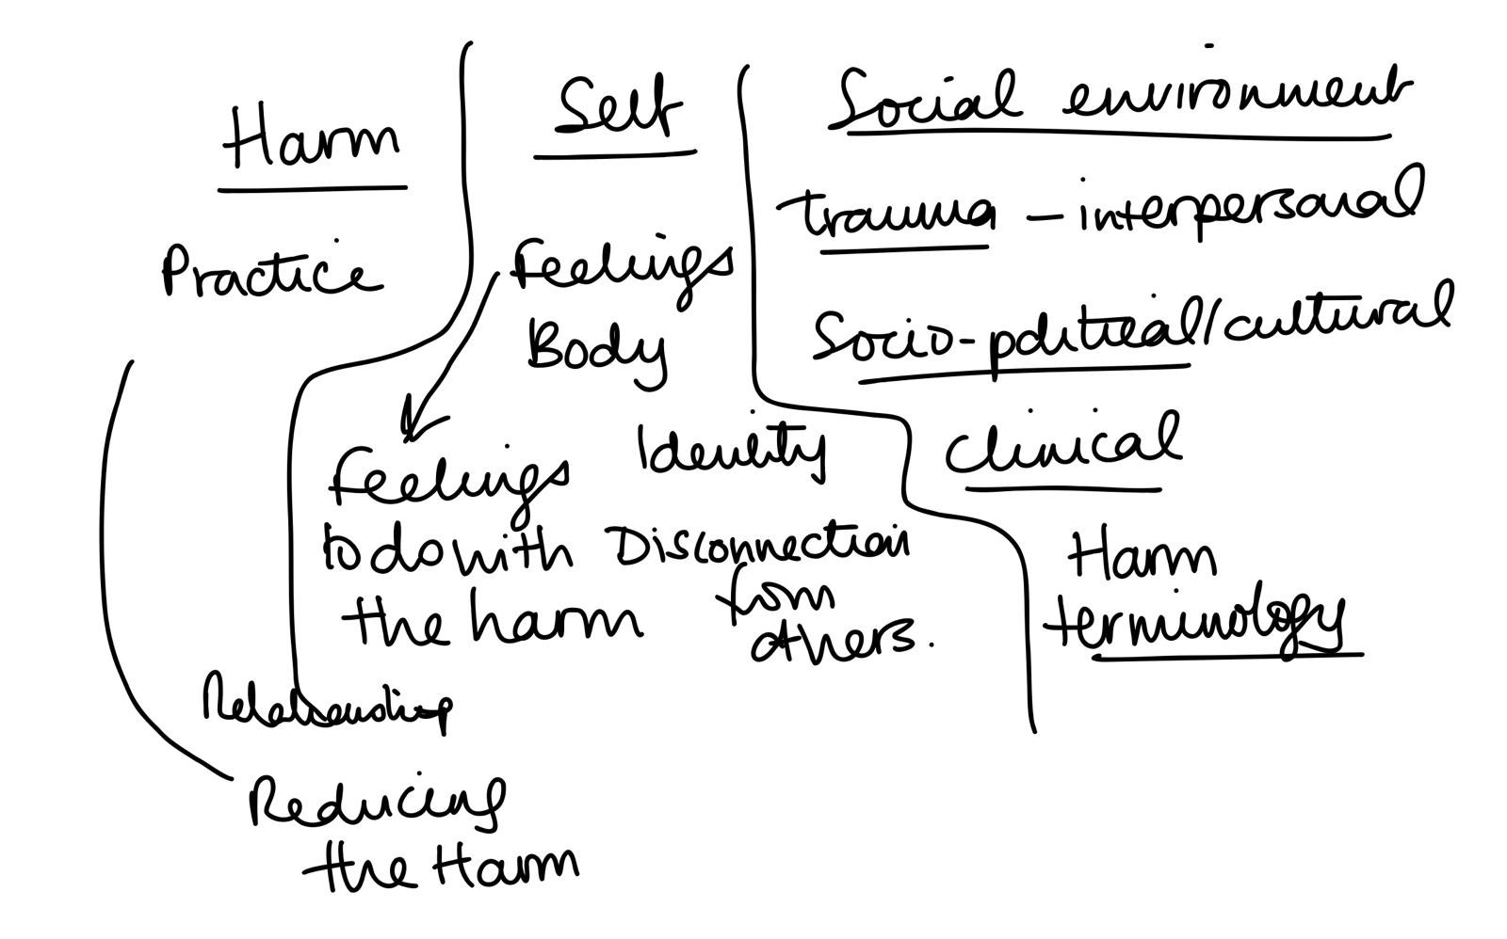
Phases 3-6: Bringing it together
Notes:
My focus was to deviate from the psychiatric construction of the pathogenic individual, who appears an isolated entity, to consider how they may be mediated by society, where the personal is suffused with social life (Malson, 2023).

Slide 26
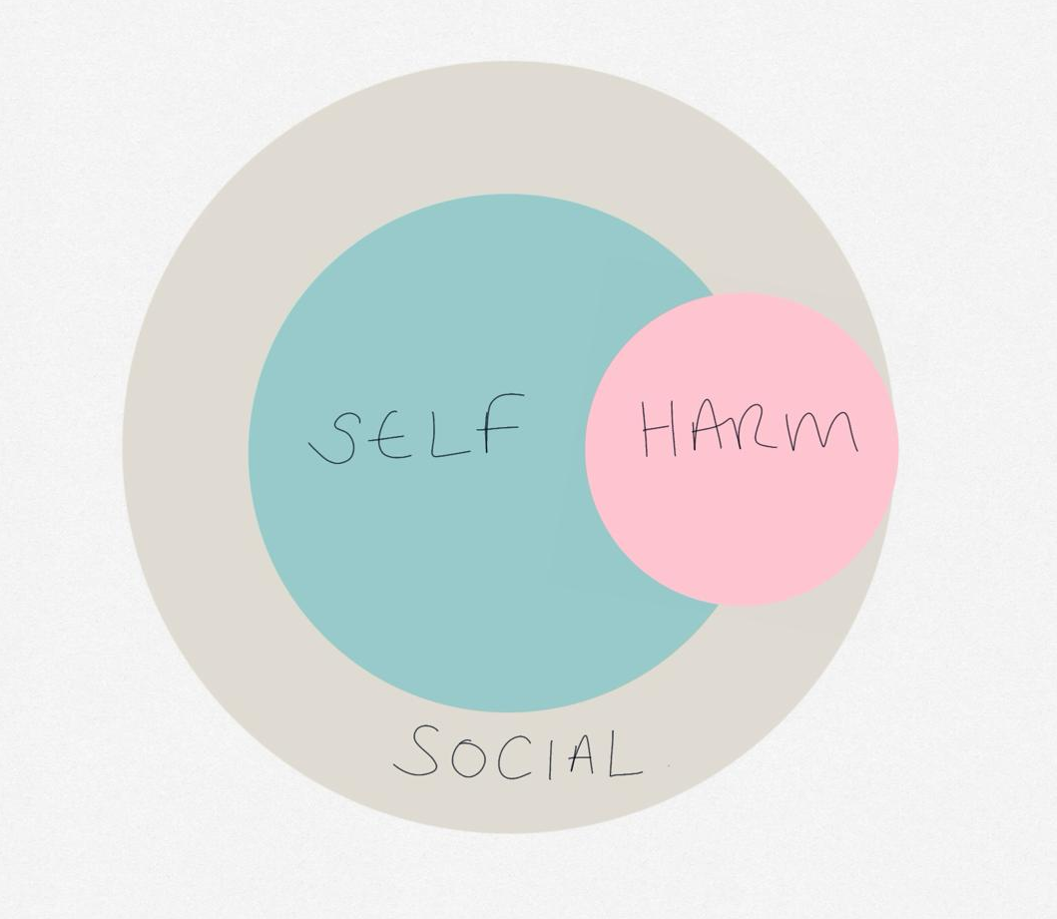
Phases 3-6: Bringing it together
Notes:
Something about self-harm that extends outwards and inwards, self-to-self but also self-to others

Slide 27
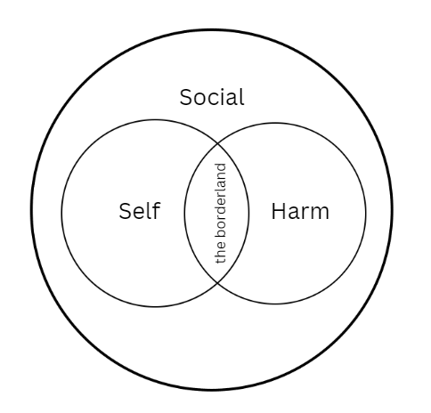
Phases 3-6: Bringing it together

Slide 28
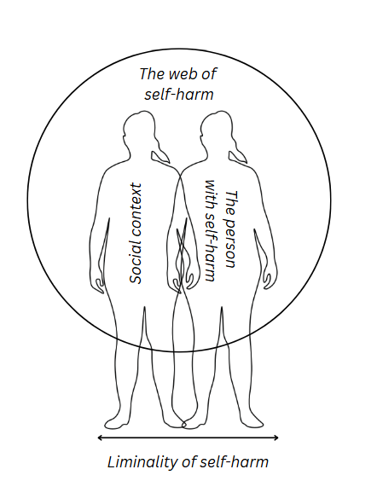
Phases 3-6: Bringing it together

